Slide 1
Web data scraping and text analysis
Strategic Direction Proposal
for Dongwon F&B's ‘Frozen Dumplings’
- Positioning Proposal through Text Big Data Analysis -
Web data scraping and text analysis(MGT4208) Final Project

Slide 2
[Problem motivation] Our company sees a new positioning as essential, not optional.
The 400 billion KRW domestic frozen dumpling market, faces our company's sales decline due to an unclear positioning, lagging behind competitors. The imperative new positioning project utilizes text big data analysis of customer reviews to understand our customers and identify competitor preferences, aiming to seize market opportunities.
Our sales always in last place
New Positioning Project is a 'Necessity'
<Research Design>
Investigate how customers perceive Dongwon F&B dumplings compared to competitors
Conduct sentiment analysis
Compare sentiment scores
Identify strengths and weaknesses of Dongwon F&B and competitors to propose product improvement suggestions
Perform cluster analysis
Analyze clusters to understand customer perceptions on
(1) product (2) price (3) other factors (such as consumption patterns)
Propose product improvements by addressing weaknesses and applying competitors' strengths.
3. Suggest new positioning for Dongwon F&B

Slide 3
[Literature review]
Numerous previous studies have collected online review data and proposed improvement suggestions to companies. In particular, Chi-Hoon Kim (2022) conducted a text mining analysis on 'TripAdvisor' reviews, performing topic modeling. Based on these analyses, the study suggested improvement points for hotels.
Literature Review *
Purchase reviews are posts made by consumers who have purchased a specific product or used a service, sharing their user experiences or evaluations in the form of comments on online platforms (Lee, et al., 2013).
With a survey indicating that 90% of consumers read reviews when making purchase decisions, reviews play a crucial role and have a significant impact (Saleh, 2015; Zhao et al., 2018).
As consumer purchasing behavior shifts rapidly from offline to online, attributes of purchase reviews such as ratings, quantity of comments, and image information have emerged as representative forms of consumer participation in the digital era (Kim et al., 2013).
Chi-Hoon, Kim(2022) **
<Text Mining Analysis of Hotel Reviews Focused on TripAdvisor Reviews>
The study attempted keyword analysis, network analysis, and topic modeling analysis on collected user reviews. Through this, we identified the most frequently mentioned keywords in reviews from domestic hotel users, examined how their networks are formed, and further explored how topic modeling is possible.
*윤종필(2022),. 온라인 신선식품 전문몰에서의 구매 후기 분석, 고려대학교 대학원 **김치훈(2022). Text Mining Analysis of Hotel Reviews Focused on TripAdvisor Reviews, 건국대학교 대학원

Slide 4
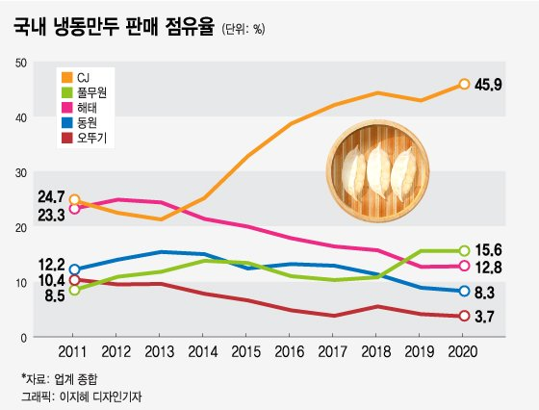
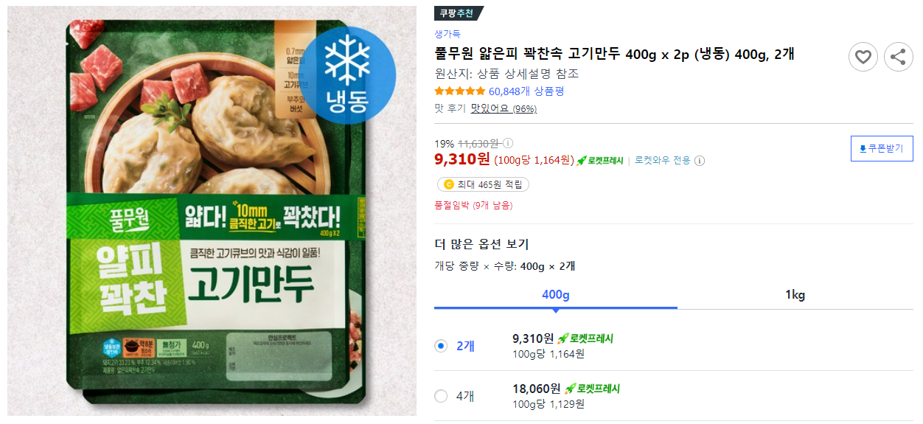
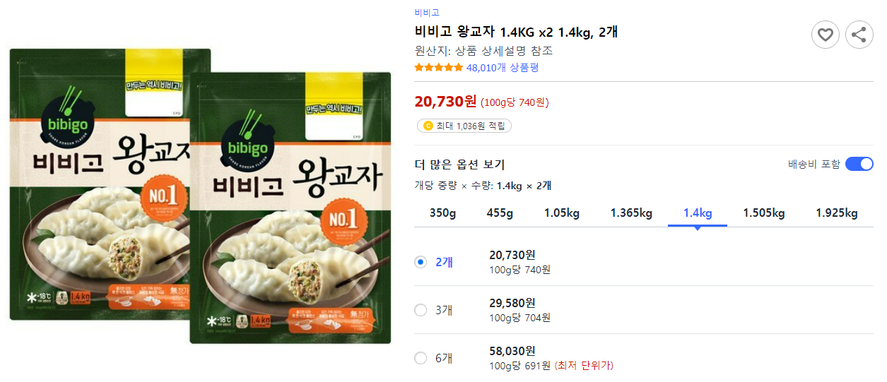
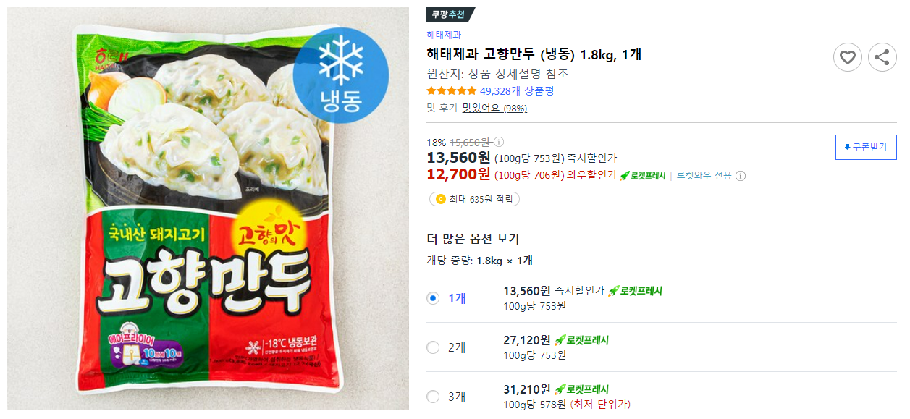
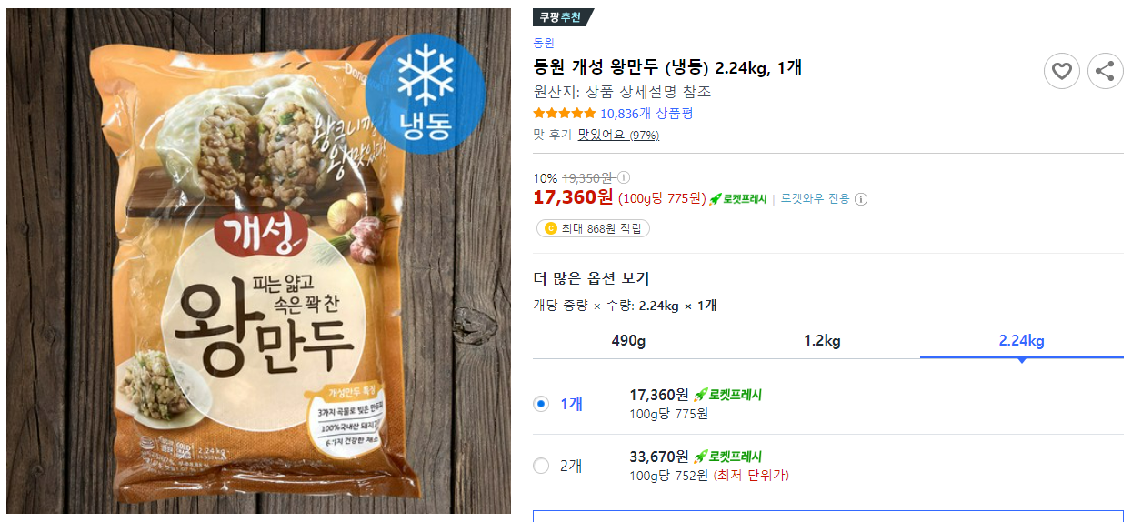
[Statement of Research Objectives] Gathering idea from Coupang review data.
As overall, We would like to analyze the review data of top 3 dumpling brands in Korea and our company by clustering method. The main objective of this research is to identity the key factors for evaluating products in dumpling market. At the end, We would like to suggest possible strategies to increase sales and market value of Dongwon’s F&B dumpling products.
Market share of dumpling
Pulmuwon “얄피 꽉찬 고기만두＂
CJ “비비교 왕교자＂
Competitor
Competitor
Haitai “고향만두”
Dongwon F&B “개성 왕만두＂
Competitor
Our Company

Slide 5
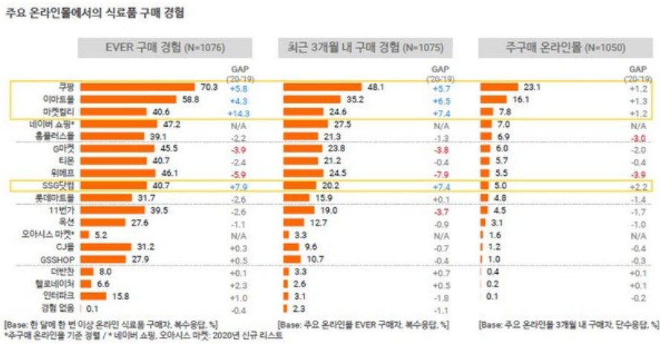
[Statement of Research Objectives] Gathering idea from Coupang review data.
The reviews were gathered from Coupang, chosen due to its dominant position in the e-commerce market. To understand how each product is received by the market, a significant number of reviews is crucial. And Coupang is considered the platform where the most definitive reactions can be observed.
Data Source
Research Goal
To understandhow each product is received by the market, a significant number of reviews is crucial
Collect and analyze Coupang review data
Confirm differences in customer perceptions between our company and competitors through sentiment analysis.
Utilize cluster analysis to precisely identify features and strengths/weaknesses of our products and those of competitors.
Based on these findings, present positioning insights
Coupang is considered
the platform where the most definitive reactions can be observed.

Slide 6
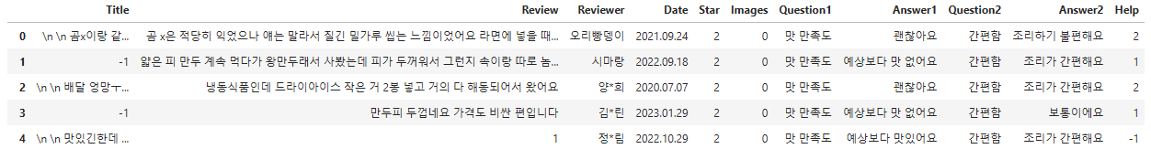




[Data and Methodlogy] 1. Data collection
The process of big data investigation and analysis involves data collection, refinement, and analysis. The textual data used in this study is unstructured, given that shopping mall reviews are written in a free format. Rigorous examination and processing of the data are necessary.
Web scraper is used.
Scraper iteratively gathers relevant reviews.
Used library:
beautifulsoup, selenium, pandas

Slide 7
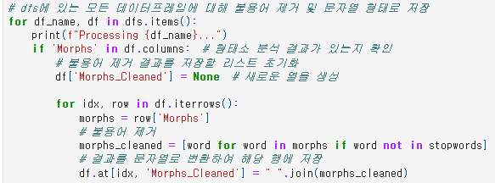
[Data and Methodlogy] 2. Text Preprocessing - Data refinement
This code removes predefined stopwords from the morphological analysis results in dataframes, storing the cleaned text as strings in a new column named 'Morphs_Cleaned.' The stopwords, defined in the variable, are excluded from the morphological analysis to refine the textual data for further analysis.
Procedure
The operations are applied iteratively to all dataframes in the dictionary.
This code refines the textual data by removing unnecessary words, leaving only the essential words in each review after morphological analysis.

Slide 8
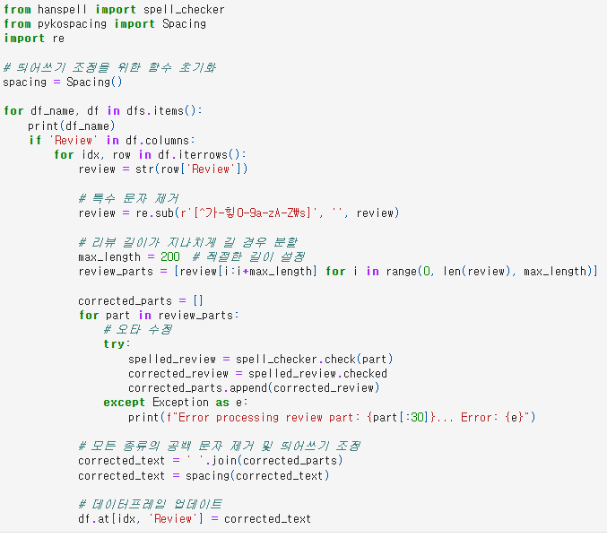
[Data and Methodlogy] 2. Text Preprocessing - Data refinement
In the data filtering and refinement process, special characters were removed, and reviews were segmented to a maximum length of 200 characters. Typographical errors were corrected using the Hanspell library, and spacing issues were addressed with the pykospacing library.
Procedure
Used reg exp ‘re.sub(r'[^가-힣0-9a-zA-Z\s]', '', review)’ to eliminate non-Korean, non-English, and spaces.
Set a maximum length of 200 characters to manage lengthy reviews. Segmented reviews into parts using the code ‘review_parts = [review[i:i+max_length] for i in range(0,len(review), max_length)]’
Used the Hanspell library for spell-checking with the code
‘spelled_review = spell_checker.check(part)’.
Corrected typos in the reviews to enhance the overall text quality.
Utilized the pykospacing library to adjust spacing. Applied the code ‘corrected_text = spacing(corrected_text)’ to ensure proper spacing in the refined text.

Slide 9
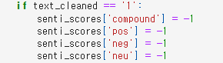
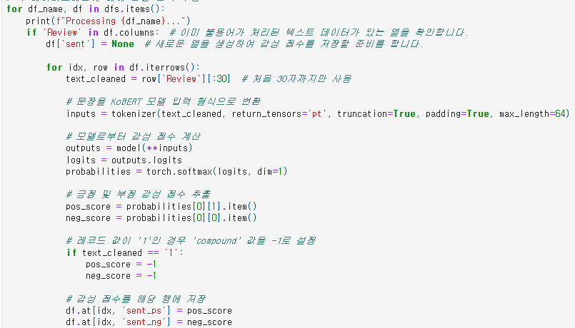
[Data and Methodlogy] 3. Sentiment Analysis
The code applies VADER sentiment analysis to assess sentiment in customer reviews, adjusting for strong negativity in labeled '1' reviews. It further integrates KoBERT for deep learning-based sentiment analysis, offering nuanced insights into sentiments, especially in complex language structures.
Procedure
Star rating of '1' often corresponds to a strongly negative sentiment in reviews, setting the sentiment scores to -1 is intended to portray such reviews as expressing intense negativity.
Text is tokenized and converted into input format of KoBERT model.
Calculate sentiment scores, probabilities for positive and negative sentiments.
Positive and negative sentiment scores are then stored.

Slide 10
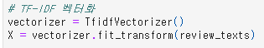
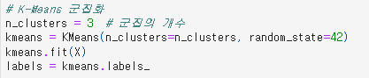
[Data and Methodlogy] 4. Clustering Analysis – K means
Study used K-Means clustering, utilizing TF-IDF vectorization to represent reviews numerically based on word importance. Clustering analyzed reviews with ratings 1 or 2 and 4 or 5, revealing strengths, weaknesses, and sentiments for product improvement.
Procedure
Utilized TfidfVectorizer to transform text data into numerical values using the TF-IDF format, representing each review with numerical importance assigned to words.
The variable `n_clusters` specifies the number of clusters.
After clustering, the `get_top_features_cluster` function was utilized to extract pivotal words from each cluster, facilitating a deeper understanding of their unique characteristics.
Clustering analyzed reviews with ratings 1 or 2 and 4 or 5,
revealing strengths, weaknesses for product improvement.
By identifying distinctive words and topics, businesses gained insights into diverse customer opinions,
enhancing products across different rating ranges.
This approach provided a nuanced understanding of customer feedback.

Slide 11
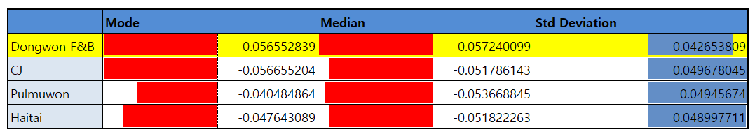
[Analysis Result] Sentiment Analysis
Based on the sentiment analysis results, the average sentiment score for our company is -0.0572, significantly lower compared to competitors. This indicates that our product is perceived much more negatively by customers in comparison to competitors. Therefore, it is crucial to improve products.
The need for improvement
Through sentiment analysis, the average score for our company is -0.0572 (standard deviation 0.04265).
Comparing this to the average scores of competitors, which are -0.0517, -0.0536, and -0.0518, our score is noticeably lower.
Star 1 Review
Star 2 Review
Star 3 Review
This indicates that negative sentiments are more pronounced in customer reviews for our products.
Therefore, it further emphasizes the necessity for product improvement through this project.
Star 4 Review
Star 5 Review

Slide 12
[Analysis Result] Clustering Analysis
The cluster analysis revealed clusters related to various features of each company's products. These clusters were further interpreted by categorizing them into (1) Product (filling, wrapper), (2) Price, and (3) Others (consumption methods, etc.). Additionally, insights were derived based on the research results to apply a new positioning for Dongwon F&B.
 |  |  | cluster | Analysis Result | Insight
product | Filling | Dong won F&B | [군집 1-2] 물컹물컹, 식감, 느낌, 떨어지다 | Although our dumplings are generously filled and meet customer needs with a substantial quantity, there is an identified issue with the dumpling filling being too mushy, leading to a compromised texture. | Complaints about the filling can be categorized into ⓐ texture (mushy), ⓑ unpleasant odor, and ⓒ excessive use of strong seasonings (too salty). Therefore, there is a need to develop a filling that maintains an optimal texture and eliminates the meaty odor. In contrast to competitors such as our company, Pulmuone, and Haitai, CJ does not seem to have negative evaluations regarding the dumpling filling. CJ adopts a processing method of 'chopping' rather than 'grinding' the filling to eliminate unpleasant odors, indicating the necessity for process R&D to preserve the texture.
 |  | CJ |  | Since CJ is the only one without negative feedback on taste, it is crucial to incorporate reflections on CJ's dumpling production technique.
 |  | Pul Mu Won | [군집 1-1] 별로, 느끼하다, 맛없다 [군집 1-3] 짜다, 고기, 냄새, 맛없다 [군집 2-3] 짜다, 고기 | The meaty odor, greasiness, and excessive saltiness are confirmed to be compromising the taste.
 |  | Haitai | [군집 1-1] 조미료, 강하다 | The strong seasoning is adversely affecting the overall flavor. Haitai's dumpling products receive more reviews stating a relatively bland taste compared to other brands.
 | Wrapper | Dong won F&B | [군집 1-3] 만두피, 두껍다, 힘들다 | The thick dumpling wrapper causes inconvenience for customers during consumption. | Considering the trend of 'thin dumpling wrappers' following the success of Pulmuone's 'Yalpi Mandu,' R&D efforts are required to reduce the thickness of the dumpling wrapper. Moreover, in terms of the product, considering CJ's emphasis on 'good dumpling filling' and Pulmuone's focus on 'thin dumpling wrappers' meeting customer needs, our company needs to strategize for a distinct product identity.
 |  | CJ
 |  | Pul Mu Won | [군집 2-1] 얇다, 좋다 [군집 2-2] 얇다, 정말, 최고, 만두피 | Pulmuone promotes 'Yalpi Mandu' as a product featuring thin dumpling wrappers, and the cluster analysis indicates a preference for thin dumpling wrappers.
 |  | Haitai

Slide 13
[Analysis Result] Clustering Analysis
 |  |  | Cluster | Analysis Result | Insight
Price |  | Dong Won F&B | [군집 1-3] 비싸다, 가격 등 [군집 2-1] 가격, 가성비, 저렴하다 | It can be inferred that our company's pricing positioning is not clearly defined, as there are clusters both indicating high prices and conflicting clusters suggesting cost-effectiveness and affordability. | In the case of CJ and Haitai, similar to frozen dumplings, the affordable pricing leaves a positive impression on customers, emphasizing the importance of pricing positioning. However, when the actual prices are compared, CJ's dumplings are positioned as so-called premium dumplings, being 10-20% more expensive than those perceived as affordable, such as Haitai. Therefore, efforts should be made to ensure that customers perceive the pricing as reasonable relative to the product quality.
 |  | CJ | [군집 2-1] 많다, 저렴하다, 매달 [군집 2-2] 저렴하다 [군집 2-3] 가격, 좋다, 저렴하다, 용량, 착하다 | With multiple clusters highlighting good prices, ample quantity, and affordability, it is evident that CJ's pricing is perceived as budget-friendly by customers, presenting a significant advantage.
 |  | Pul Mu Won
 |  | Haitai | [군집 2-1] 용량, 많다 [군집 2-2] 가격, 싸다, 저렴하다, 용량 [군집 2-3] 가격, 저렴하다, 가성비 | Similarly, the presence of clusters emphasizing good prices, ample quantity, and affordability indicates that Haitai's pricing is perceived as budget-friendly by customers, serving as a significant advantage.
Others | Brand | Dong Won F&B | [군집 2-2] 개성, 왕만두 [군집 2-3] 개성, 왕만두 | The frequent mention of '개성 왕만두' (Unique King Mandu) implies that our brand has firmly established itself in customer awareness. | While our brand and flagship product, '개성 왕만두' (Unique King Mandu), are clearly recognized by customers, we do not dominate the market as overwhelmingly as '비비고 왕교자' (Bibigo King Mandu), which is evident even in reviews from other brands. Therefore, benchmarking CJ's brand imprint strategy and attempting to enhance brand awareness are necessary.
 |  | CJ | [군집 2-1] 비비고, 역시, 항상 [군집 2-2] 비비고, 왕교자 [군집 2-3] 비비고 | The inclusion of words like '역시' (as expected) and '항상' (always) suggests the existence of loyal customers who frequently purchase Bibigo products. This indicates a high level of brand loyalty.
 |  | Pul Mu Won | [군집 2-1] 풀무원, 비비고 | The emergence of a cluster comparing Pulmuone and Bibigo suggests that when customers think of frozen dumplings, Bibigo products are the first to come to mind. This suggests a high level of brand loyalty.
 |  | Haitai | [군집 1-1] 옛날, 예전, 고향 | The use of words like '옛날' (old) and '예전' (in the past) indicates that Haitai is recognized by customers based on memories of consuming their first frozen dumplings, as they were the first company to develop them. This historical connection contributes to brand recognition among customers."

Slide 14
[Analysis Result] Clustering Analysis
 |  |  | Cluster | Analysis Result | Insight
Others | Consumption Methods | Dong Won F&B | [군집 2-2] 찌다, 넣다, 끓이다, 만두국 | The customer's dumpling consumption methods include ⓐ steaming and ⓑ using as an ingredient in other dishes (dumpling soup) | The customer's dumpling consumption methods include ⓐ steaming, ⓑ baking (using an air fryer, etc.), and ⓒ using as an ingredient in other dishes (dumpling soup, ramen). Considering the customer's consumption habits, there is a need for future product development that takes these methods into account.
 |  | CJ | [군집 2-1] 만둣국, 찌다, 굽다 [군집 2-3] 간식, 아이
 |  | Pul Mu Won | [군집 2-2] 만둣국, 에프, 돌리다
 |  | Haitai | [군집 1-1] 라면, 만들다 [군집 2-1] 찌다, 넣다, 굽다
 | Others | Dong Won F&B | [군집 1-1] 배송, 머리카락, 버리다 등 | Poor delivery conditions resulted in product breakage, and there have been instances where foreign substances were found, leading to the disposal of dumplings | As common delivery issues have been identified, corrective measures are necessary in packaging and other aspects. Furthermore, complaints regarding basic foreign materials have been noted in comparison to our company and competitors, emphasizing the need for efforts to improve quality.
 |  | CJ | [군집 1-1] 늦어지다, 너무, 배송, 제품, 찢어지다, 냉동, 상태, 힘들다 [군집 1-2] 녹다, 배송, 오다, 너무, 아이스팩, 냉동식품, 인데 [군집 1-3] 부서지다, 상자, 배달, 신경, 스티로폼, 반품, 포장 | delivery issues have been identified
 |  | Pul Mu won
 |  | Haitai | [군집 1-2] 배송, 녹다 | delivery issues have been identified

Slide 15
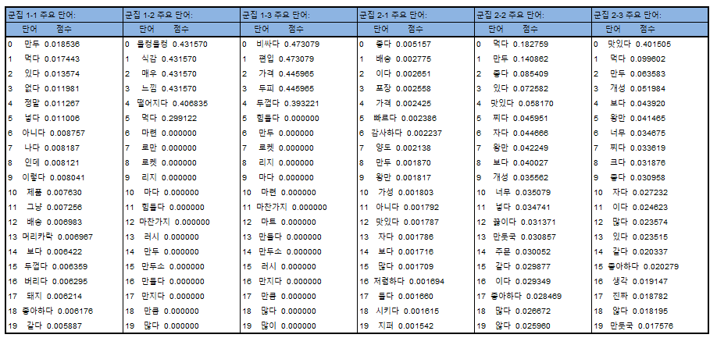
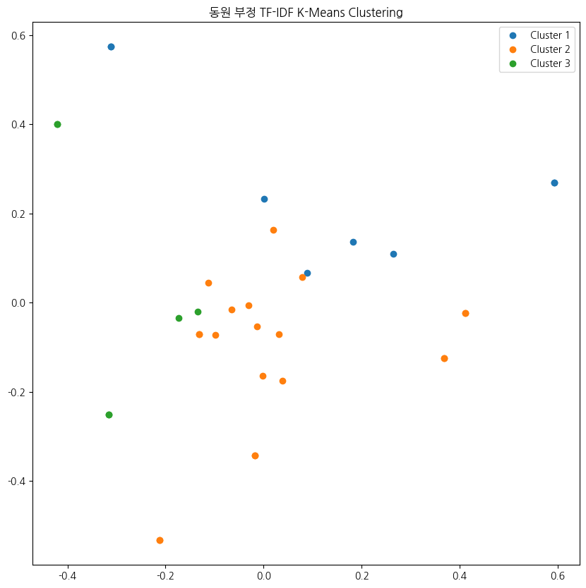
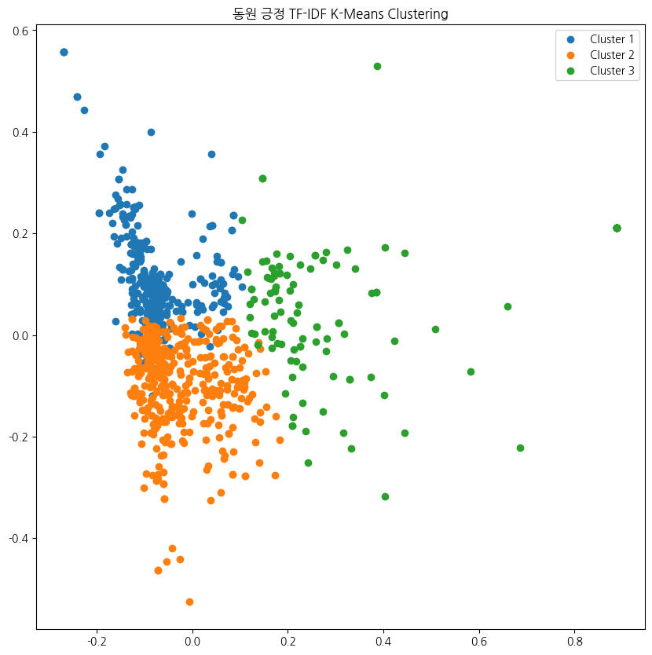
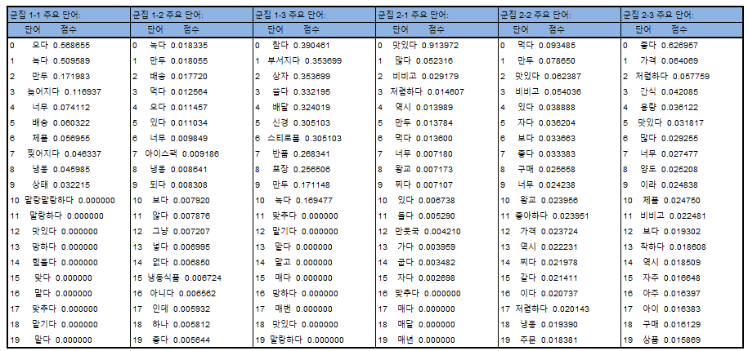
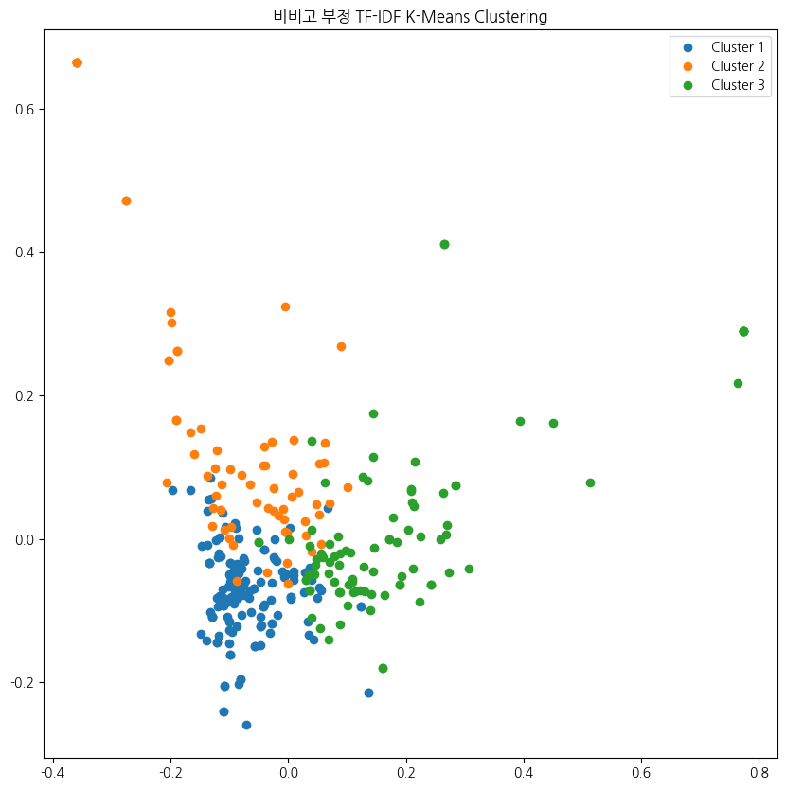
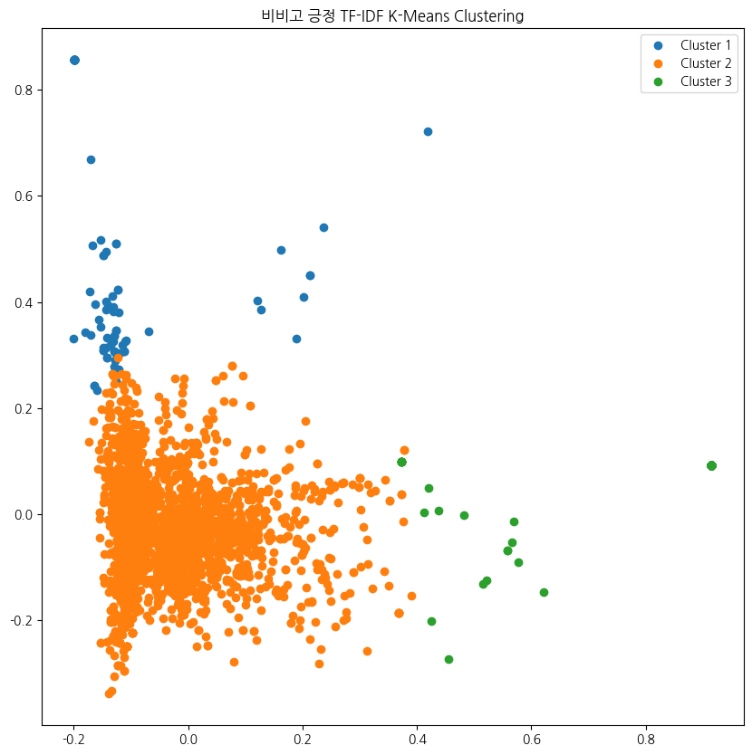
(Appendix) K-means Output
Dongwon F&B
Negative K-Means Clustering
Positive K-Means Clustering
CJ
Negative K-Means Clustering
Positive K-Means Clustering

Slide 16
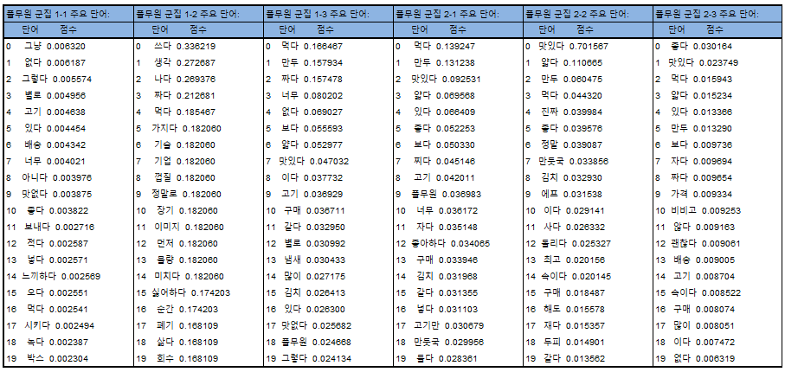
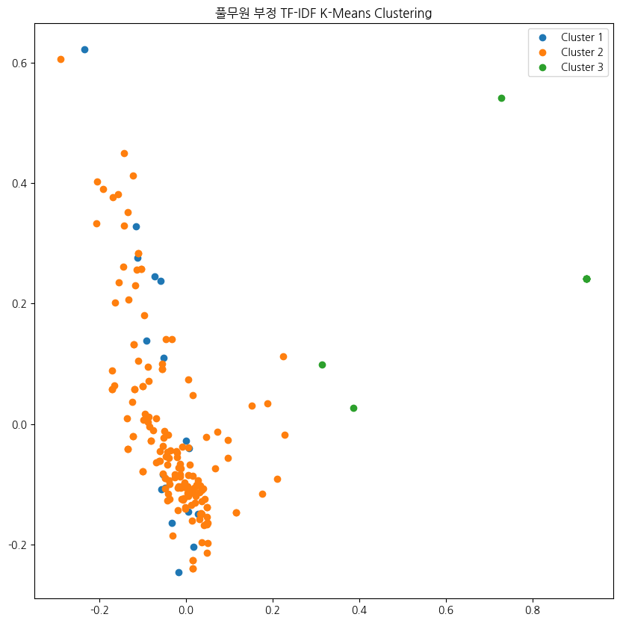
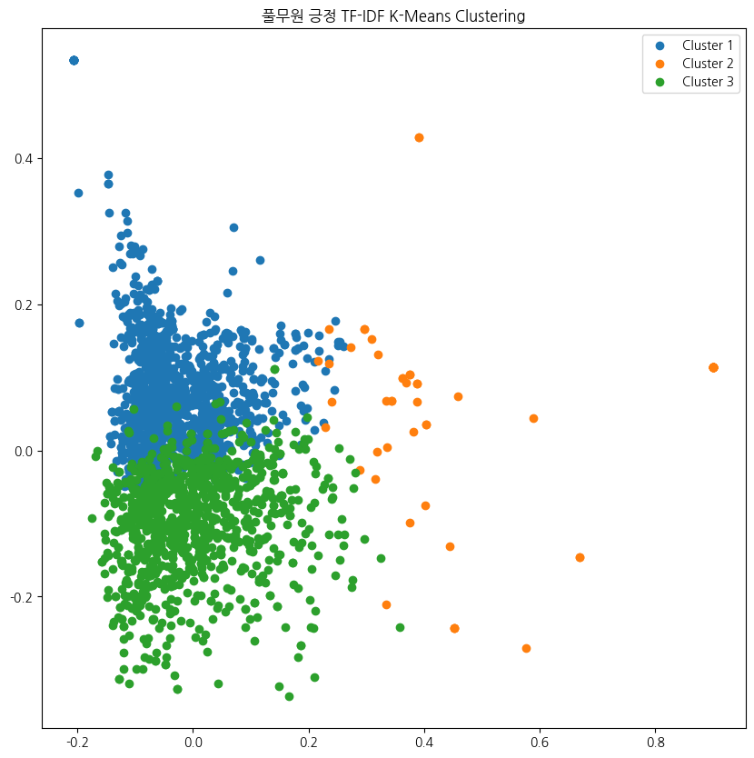
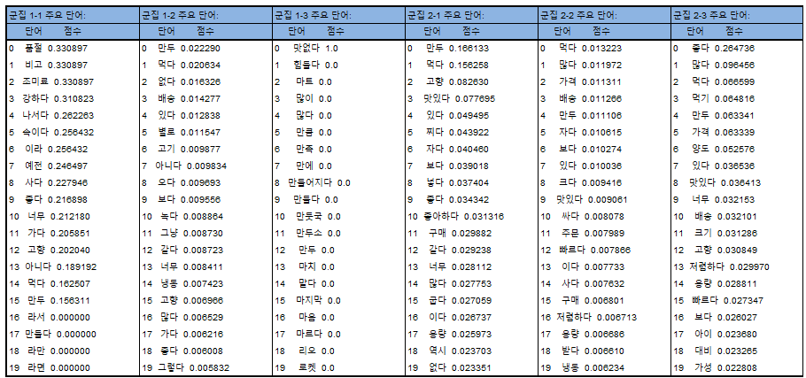
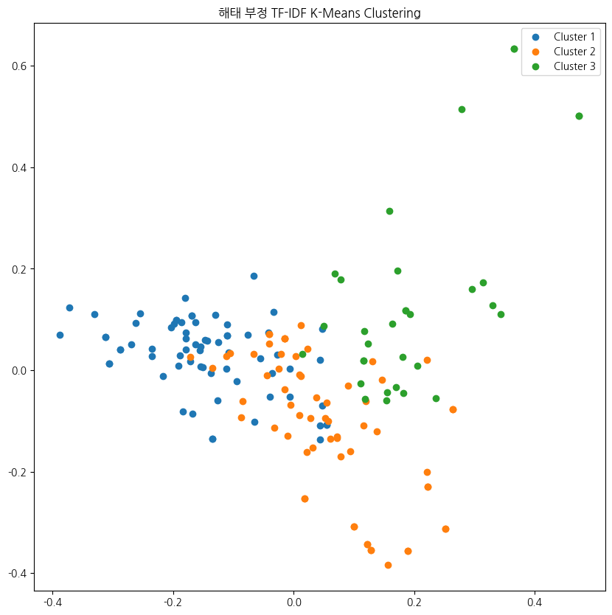
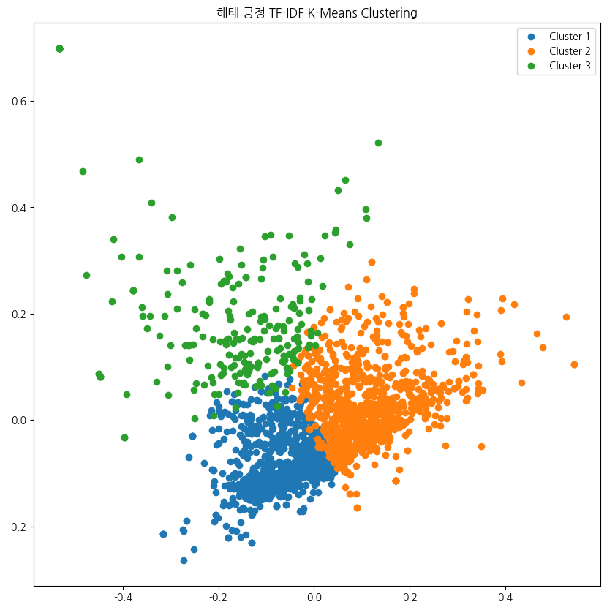
(Appendix) K-means Output
Pulmuwon
Negative K-Means Clustering
Positive K-Means Clustering
Haitai
Negative K-Means Clustering
Positive K-Means Clustering

Slide 17
[Expected original contribution]
Through the current project, we can identify the strengths and pain points that customers associate with Dongwon products, providing valuable insights for product improvement. This approach will serve as a key factor in fostering revenue growth.
Product Improvement Proposal
Price Positioning
Annual Revenue Enhancement
Product | Filling | - Adopt a processing method of ‘Chopping’
 | Wrapper | - Reduce the thickness - Strategize for a distinct product identity
Price |  | - Pricing positioning
Others | Brand | - Benchmark CJ’s brand strategy to enhance brand awareness
 | Delievery | - Enhance packaging
<Price>
expensive
CJ
Pulmuwon
<Quality>
Low
High
Our company
Suggested
Position
Haitai
(Current)
418
billion
(Expect)
600
billion
cheap

Slide 18
[Reference List]
윤종필(2022). 온라인 신선식품 전문몰에서의 구매 후기 분석, 고려대학교 대학원
김치훈(2022). Text Mining Analysis of Hotel Reviews Focused on TripAdvisor Reviews, 건국대학교 대학원
채진해 등(2020). 텍스트 빅데이터 분석을 통한 COVID-19 전후 서울시 주요 도시공원의 시민 이용행태 및 관심도 변화, 2020서울연구논문공모전
조우리 등(2021). 텍스트마이닝을 활용한 SNS 내 미술 전시 감상 후기 분석, 조형교육 79집
중소기업벤처진흥공단 (2019). KOSME 산업분석 리포트-음식류: 간편식(HMR)-

Slide 19
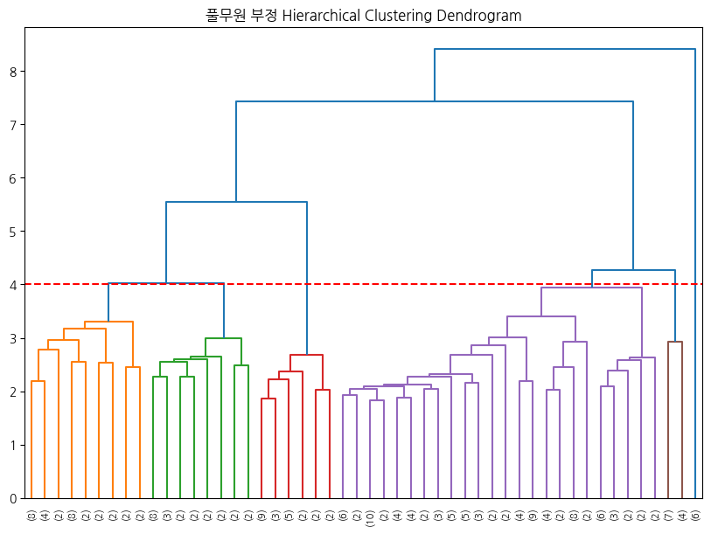
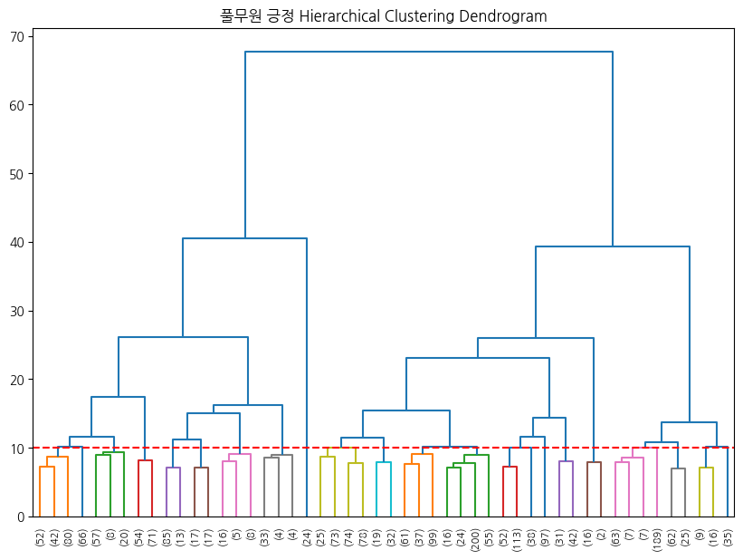
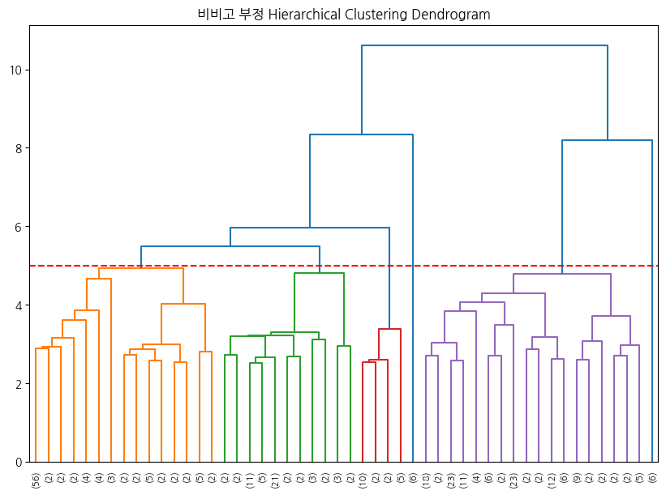
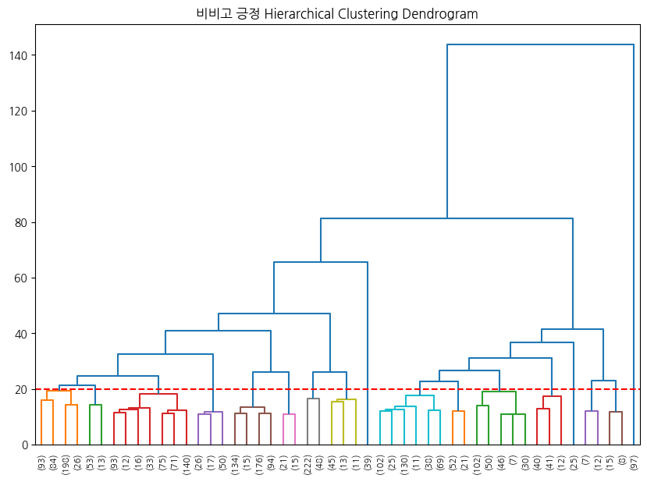
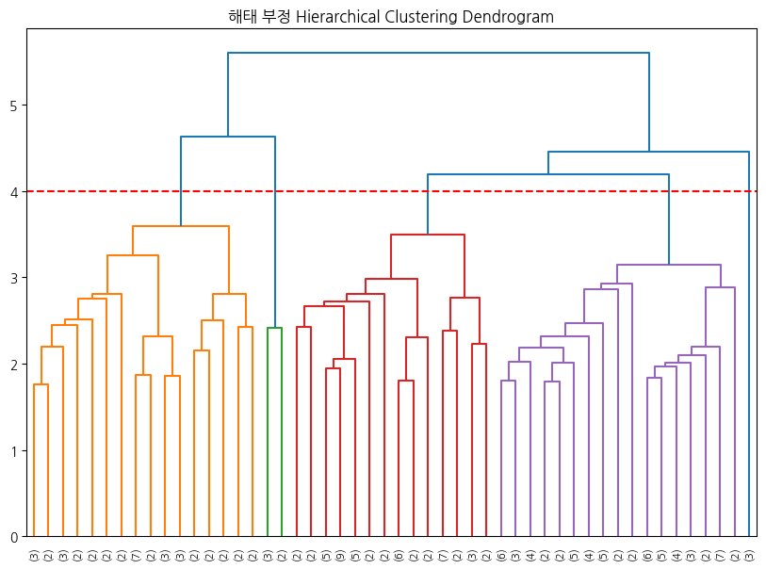
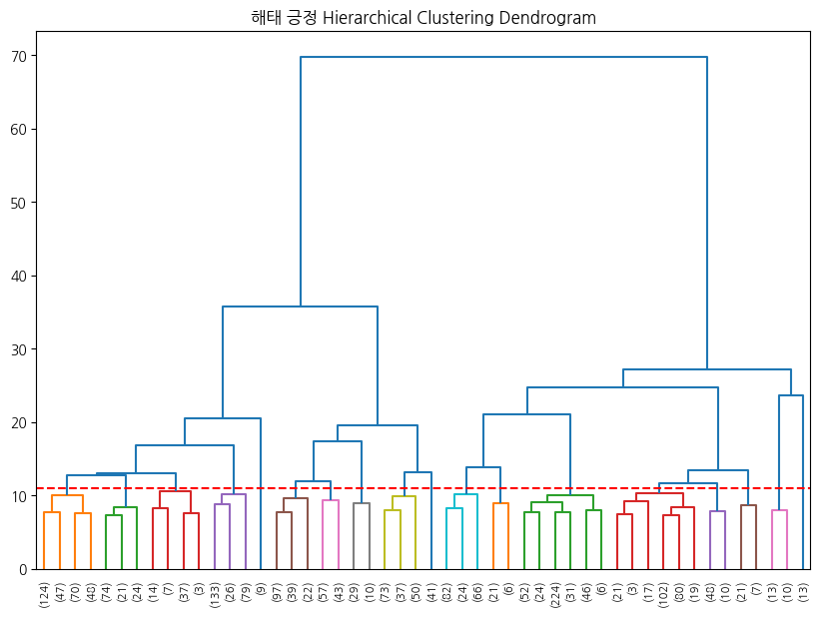
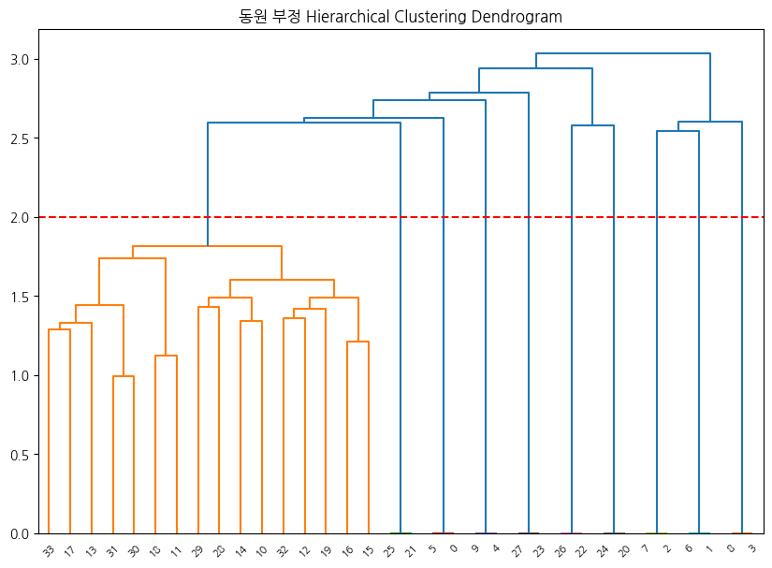
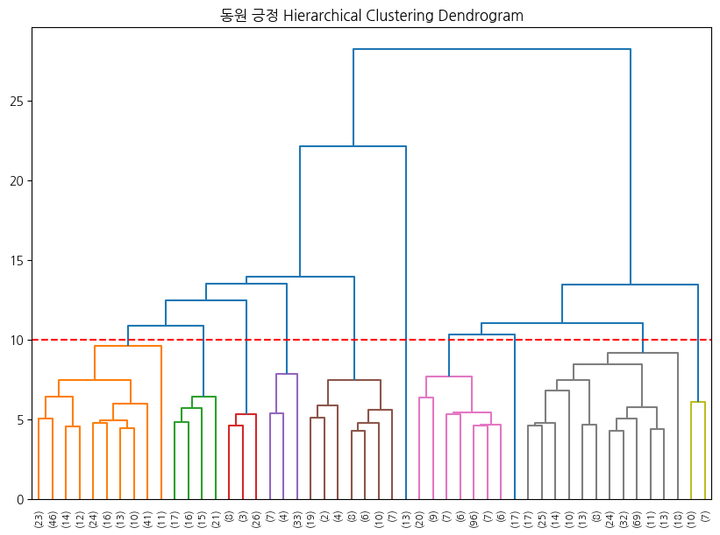
(Appendix) Hierarchical Clustering Output
To understand customer perceptions of our company and competitors' product features, we conducted not only k-means cluster analysis but also went further to include Hierarchical Clustering and Topic Modeling. While our primary intention was to derive insights, we found that k-means cluster analysis was the most effective in achieving this goal. Therefore, we centered our utilization of the research results around the outcomes obtained from k-means cluster analysis.
“Pulmuone” Hierarchical Clustering Dendrogram
“Bibigo” Hierarchical Clustering Dendrogram
“Haitai” Hierarchical Clustering Dendrogram
“Dongwon F&B” Hierarchical Clustering Dendrogram

Slide 20
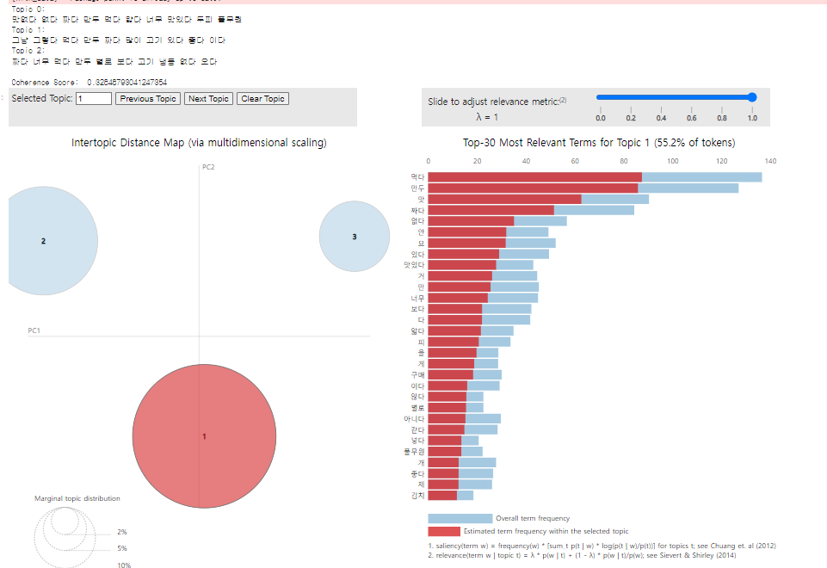
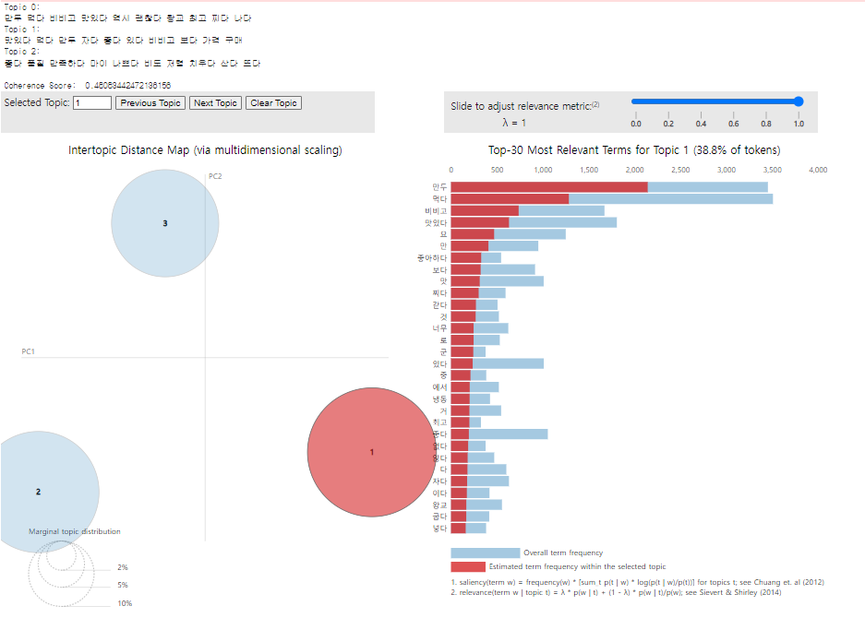
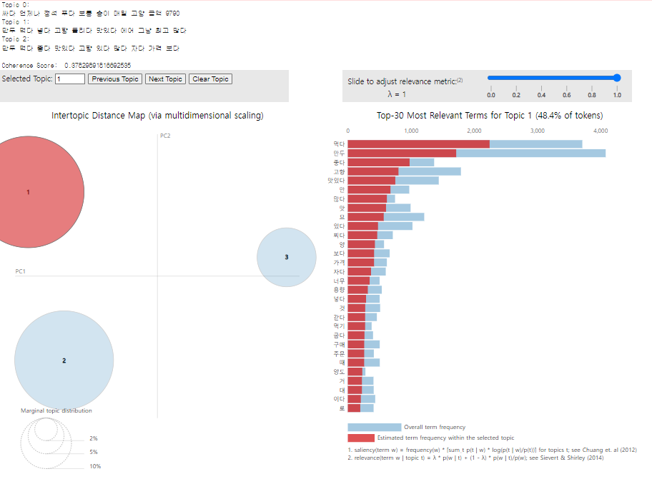
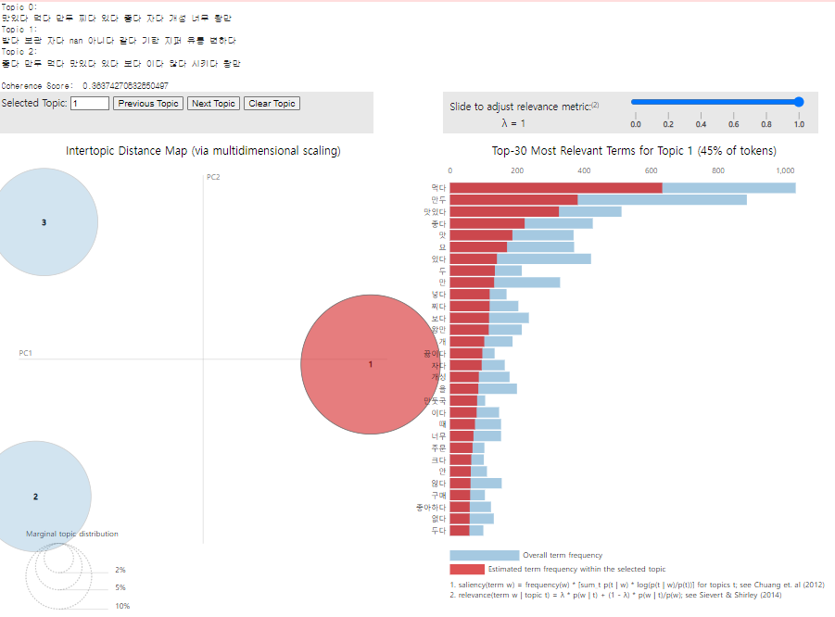
(Appendix) Topic Modeing Output
“Pulmuone”
“Bibigo”
“Haitai”
“Dongwon F&B”

